Slide 2
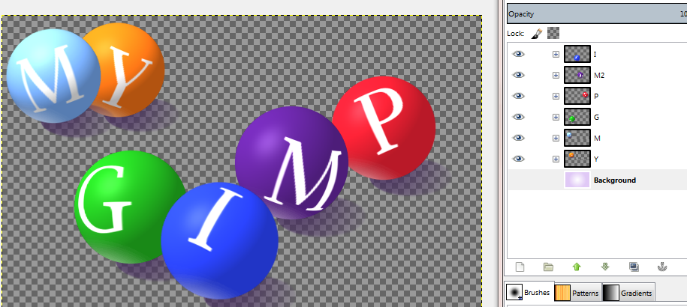
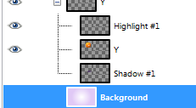
One of our final designs for this class will be a portfolio of our GIMP work. This banner is an example, you do not have to create this banner, but you do need to make one for your GIMP Portfolio site.
So let’s make a banner for our site.
We are going to create a new banner and add our 3D sphere, and add the word “Portfolio”.
First we need to make some changes to our spheres.
Open Gimp and open My_GIMP_3D_sphere.xcf
Click on the eye next to the background to make it invisible. Then save as My_GIMP_3D_sphere_clear.xcf, then export it as a .png (also with _clear).
Even if you like the purple background you will need to re create it as our banner is a different size.
Note: we have sphere shadows in a dark purple. This may or may not work with your final color. You can always hide the shadows or create a new color shadow and copy and position it for the rest of the letters.

Slide 3
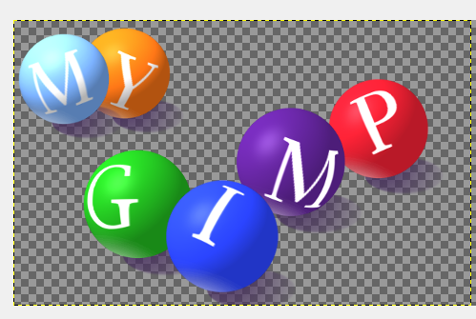
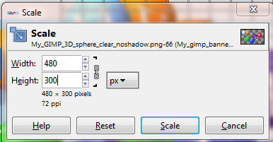
Open GIMP and make a new image
1000px by 300px.
Drag and drop the 3D_sphere onto the canvas.
Next scale your sphere using Layer | Scale. Make sure the link is connected and change the height to 300px. Drag the image to the left and position it at the edge of the canvas.

Slide 4
Add a background color of you choice.
I added blue in a FG to BG radial design. You can use anything you like; after all, this is YOUR portfolio ☺.
So that you can see the difference, I also created a no shadow version. Notice that the shadows give it a perspective of being on a surface , where no shadows make the spheres look like they are in mid air.

Slide 5
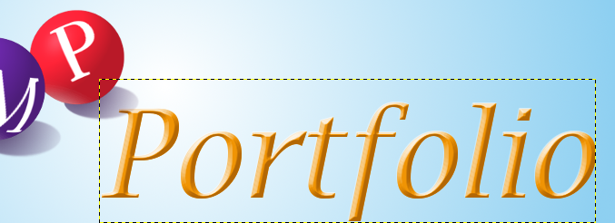
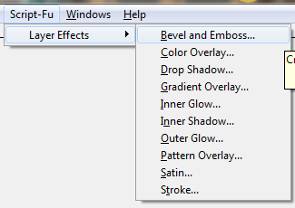
Add the word Portfolio to your banner and add an text effect.
I used Bevel and Emboss with an Lucida Bright italic, orange font and a dark orange shadow color with inner bevel.
You can choose whatever color and text effect you would like ☺.
When you are done, save the image as “my_portfolio_banner.xcf” and export it in .png format.

Slide 6
Here are a few versions…
Remember this is your banner for your site, so have fun ☺

